Slide 1

MINOR PROJECT – INTERNET OF THINGS

Slide 2

MAKE LIFE EASY FOR DEAF AND DUMB PEOPLE
BY:
Khushbu Dhingra (04813502812)
Parinita Aggarwal (09413502812)
Shivani Batra (01813502812)
Shriya Gambhir (09013502812)
(ECE, 7th Sem)
PROJECT SUPERVISOR:
MS. VANDANA NIRANJAN
ASST. PROFESSOR,ECE DEPT.
IGDTUW, DELHI

Slide 3
PRESSURE COOKER
Deaf and dumb people face certain problems which are often taken for granted by others. To name a few, these problems include their inability to hear sounds like:
CRY OF A BABY
FIRE ALARM AND DOORBELL
MICROWAVE

Slide 4
OBJECTIVE OF THE PROJECT
In order to provide a viable solution for the aforementioned problems, our main aim is to:
Alert the deaf and dumb people of the common day-to-day sounds using vibrating band and led.
Send a(bluetooth) message on their phone to inform about the type of sound.

Slide 5
DESCRIPTION OF THE PROJECT
In order to demonstrate, we have taken the case of the cry of a baby.
The sound and movement of the baby is detected by the sound and motion sensor.
When both the inputs are high , the vibrating band gets activated.
Using bluetooth, a message is sent on the person’s phone in order to inform about the activity ( baby’s cry in this case).

Slide 6
TECHNOLOGY FOCUSSED
BLUETOOTH
WHY BLUETOOTH
1. Excels at short-range cable-replacement-type applications.
2. More convenient connection process than its competitors (ZigBee specifically).
3. Secure and simple wireless connections between huge numbers and types of devices.

Slide 7
HOW IT WORKS
The Bluetooth protocol operates at 2.4GHz.
Masters, Slaves, and Piconets
Uses a master/slave model to control when and where devices can send data.
Here, a single master device can be connected to up to seven different slave devices.
Any slave device in the piconet can only be connected to a single master.
Master can send data to any of its slaves and request data from them as well.
Slaves are only allowed to transmit to and receive from their master and not to each other.

Slide 8
ADVANTAGES OF USING BLUETOOTH
Opens up a whole new range of possibilities by communicating with mobile phones and PCs
Ultra-low peak, average and idle mode power consumption;
Ultra-low cost plus small size for accessories and human interface devices (HIDs);
Minimal (if any) cost and size addition to handsets and PCs;

Slide 9
Global, intuitive and secure multi-vendor interoperability.
It is based upon Adaptive Frequency Hopping (AFH) that minimises the impact of potential interference, and Forward Error Correction (FEC) that enables a receiver to not only detect, but also correct errors in a transmission.
Can be used as a highly reliable and robust wireless technology.

Slide 10
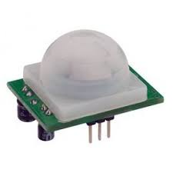
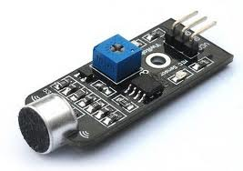
COMPONENTS USED
1. MOTION SENSOR
To detect the movement of the baby.
2. SOUND SENSOR- To detect the cry of the baby.

Slide 11
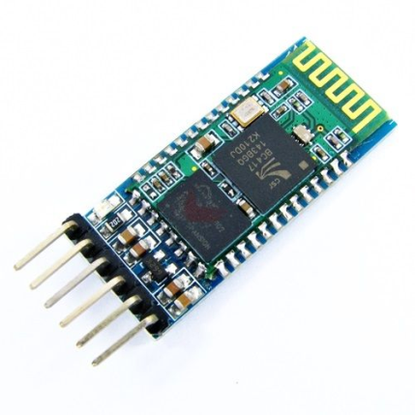
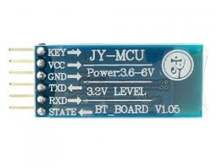
3. BLUETOOTH MODULE
To send bluetooth message on user’s phone.

Slide 12
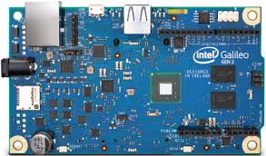
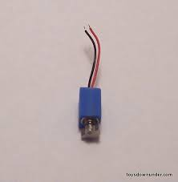
4. INTEL GALILEO GEN2
5. VIBRATING MOTOR- To alert the deaf and dumb people if an event takes place.

Slide 13
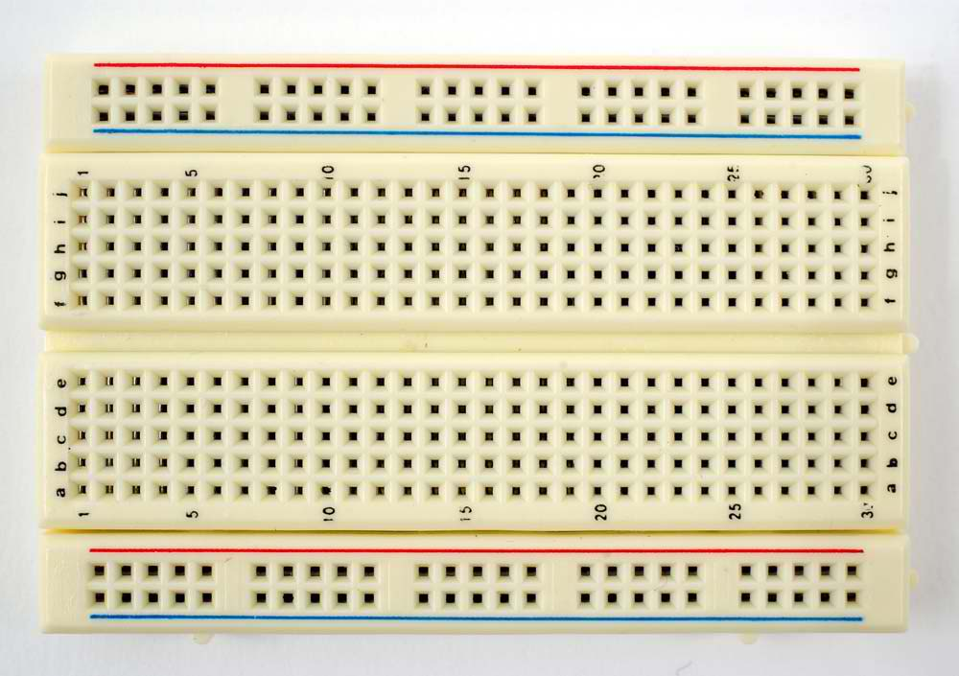
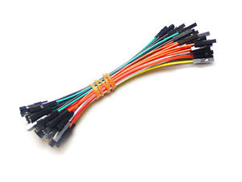
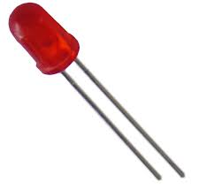
6. BREAD BOARD
7. F2F and M2M wires and LED

Slide 14
SOFTWARE REQUIREMENT-
Arduino - To interface Arduino Uno with various sensors and shields, and then programme it accordingly to get the desired results.
2. Bluetooth SPP Manager - It is an android/ios app which used to pair cell phone with arduino compatible bluetooth shield.

Slide 15
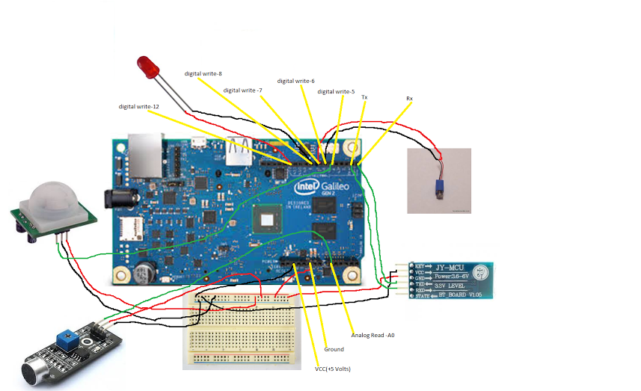
CONNECTION DIAGRAM

Slide 16
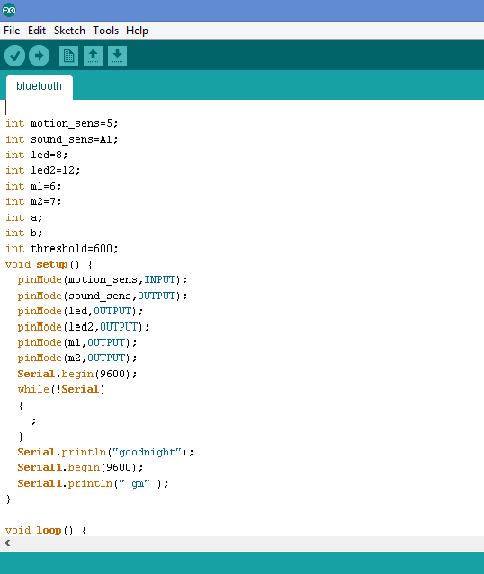
PROGRAM CODE

Slide 17
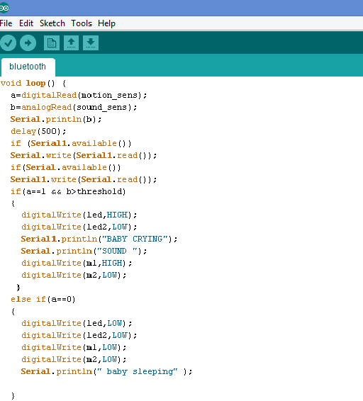

Slide 18
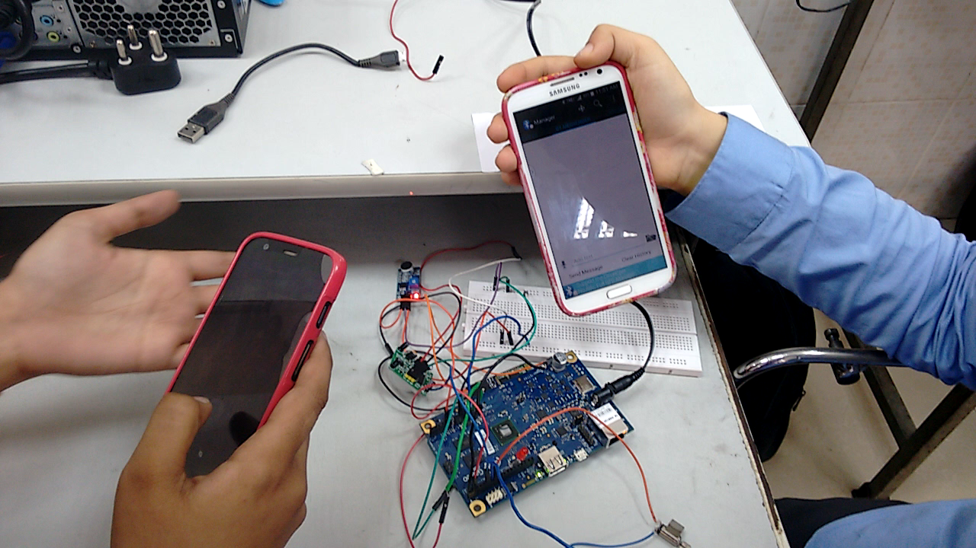
VIDEO DEPICTING HOW IT WORKS

Slide 19
RESULT AND CONCLUSION
An alerting sound system has been made using bluetooth, motor, phone and sensors to alert and differentiate between different common sounds.
This system will be of great use to the deaf and dumb.
This project has an immense potential to serve as an aid to the deaf and dumb by alleviating their day-to-day problem of not being able to judge any sound activity.

Slide 20
FUTURE SCOPE
This project has an immense potential to serve as an aid to the deaf and dumb by alleviating their day-to-day problem of not being able to judge any sound activity.
1.To focus on the wireless demonstration of the system, we have considered only the case of a crying baby. In order to widen the scope of the project, it can be extended by incorporating sounds like that of a fire alarm, doorbell, pressure cooker whistle, microwave etc and for this purpose the sound sensor can be mapped to different sound ranges.

Slide 21
2. These different sounds can further be differentiated using different coloured LEDs or different pattern of vibrations
3. Bluetooth though is a very successful and reliable means of wireless communication, its usage isn’t much encouraged for long duration or long distance communication, hence to overcome such limitations, Zigbee technology can be used.

Slide 22
THANK YOU

